Slide 1

Department of Computer Science, CUI Lahore Campus
Formal Methods in Software Engineering
By
Farooq Ahmad

Slide 2
Propositional Logic
Biconditional statements

Slide 3
Topics to be discussed
Contrapositive of conditional statements
Biconditional statements
Truth table of biconditional statements

Slide 4
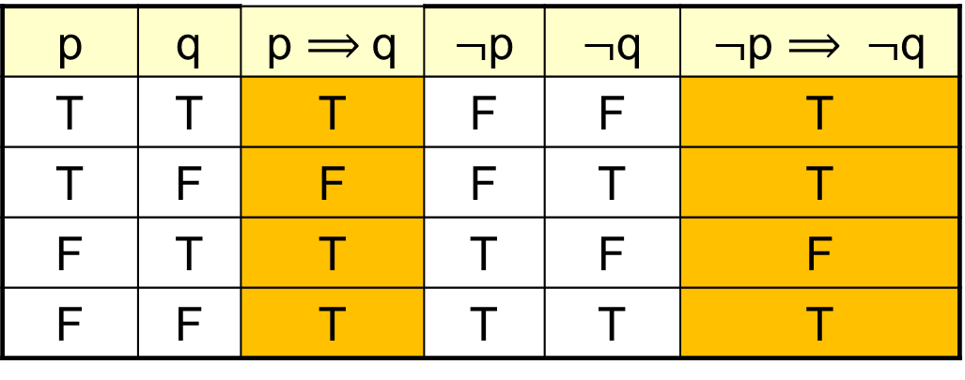
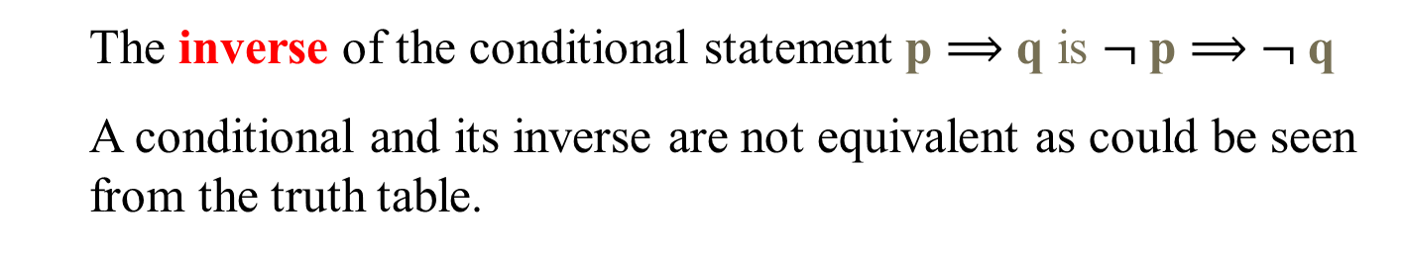
INVERSE OF A CONDITIONAL STATEMENT
The inverse of the conditional statement p $⟹$ q is $¬$p $⟹$ $¬$q
A conditional and its inverse are not equivalent as could be seen from the truth table.
p | q | p $⟹$q | $¬$p | $¬$q | $¬$p $⟹ ¬$q
T | T | T | F | F | T
T | F | F | F | T | T
F | T | T | T | F | F
F | F | T | T | T | T

Slide 5
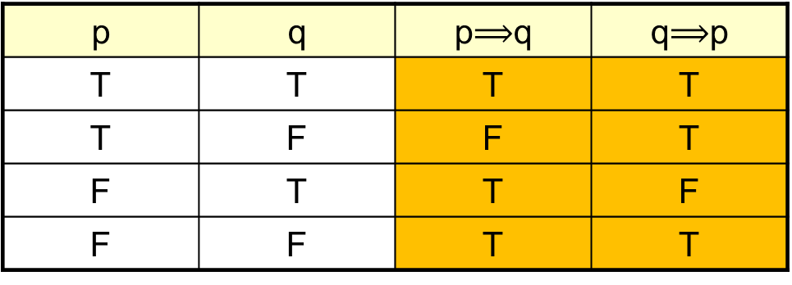

CONVERSE OF A CONDITIONAL STATEMENT
The converse of the conditional statement p $⟹$ q is q $⟹$ p
A conditional and its converse are not equivalent. That is $⟹$ is not a commutative operator.
Now since the entries in the last two columns are not same so the corresponding statement forms are not logically equivalent. That is conditional statement and its converse are not logically equivalent.
p | q | p$⟹$q | q$⟹$p
T | T | T | T
T | F | F | T
F | T | T | F
F | F | T | T

Slide 6
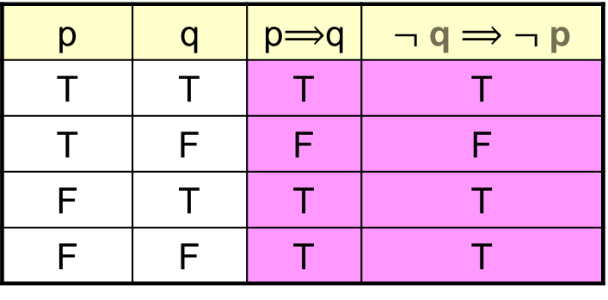

CONTRAPOSITIVE OF A CONDITIONAL STATEMENT
The contrapositive of the conditional statement p $⟹$ q is $¬$ q $⟹$ $¬$ p.
A conditional and its contra positive are equivalent.
Symbolically, p $⟹$ q ≡ $¬$q $⟹$ $¬$p as shown by the truth table below.
Note that the entries in the last two columns are same. Hence the corresponding statement forms are logically equivalent. Also note that in the above table we did not made the columns for $¬$q and $¬$ p. But you should made these columns also.
p | q | p$⟹$q | $¬$ q $⟹$ $¬$ p
T | T | T | T
T | F | F | F
F | T | T | T
F | F | T | T

Slide 7
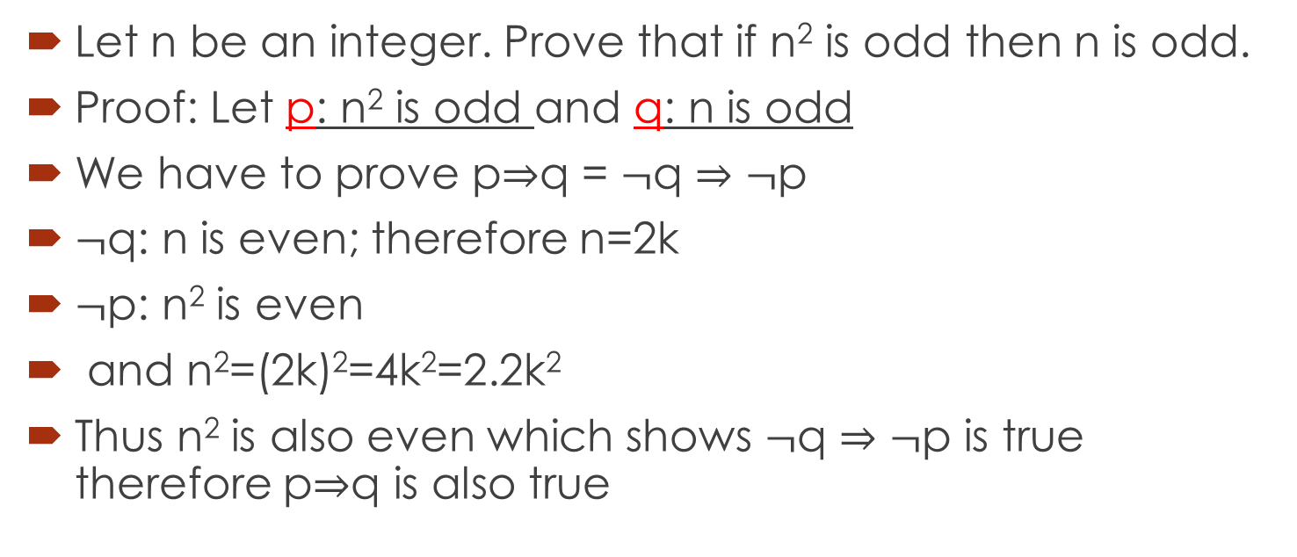
Using contrapositive for proof
Let n be an integer. Prove that if n² is odd then n is odd.
Proof: Let p: n² is odd and q: n is odd
We have to prove p$⇒$q = $¬$q $⇒¬$p
$¬$q: n is even; therefore n=2k
$¬$p: n² is even
and n²=(2k)²=4k²=2.2k²
Thus n² is also even which shows $¬$q $⇒¬$p is true therefore p$⇒$q is also true

Slide 8
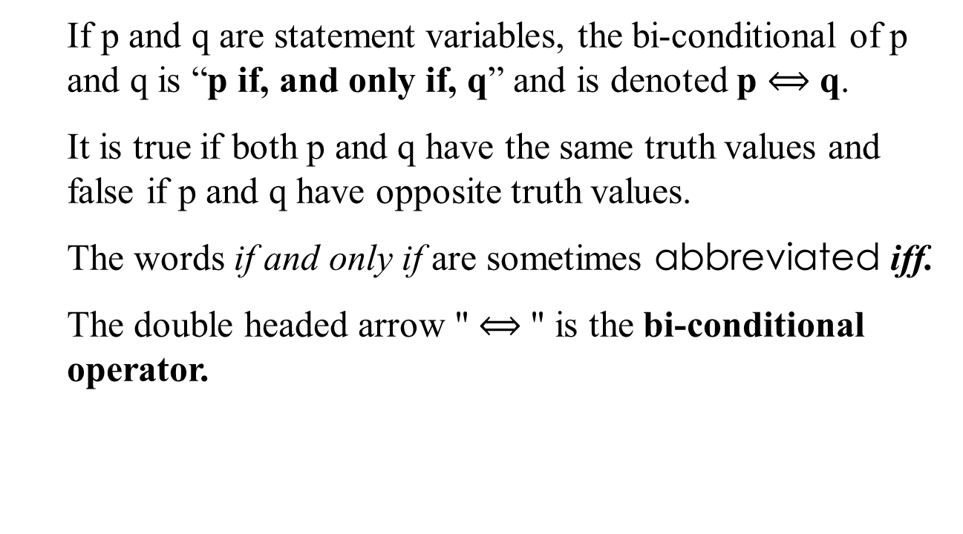
BICONDITIONAL OPERATOR
If p and q are statement variables, the bi-conditional of p and q is “p if, and only if, q” and is denoted p $⟺$ q.
It is true if both p and q have the same truth values and false if p and q have opposite truth values.
The words if and only if are sometimes abbreviated iff.
The double headed arrow " $⟺$" is the bi-conditional operator.

Slide 9
Truth value of Biconditional statements
The bi-conditional of two statements is false only when both p and q have different Truth Values. That is one have truth value T and other have Truth value F.
Equivalently we can say that bi-conditional of two statements p and q is True only when both p and q have same Truth Values.

Slide 10
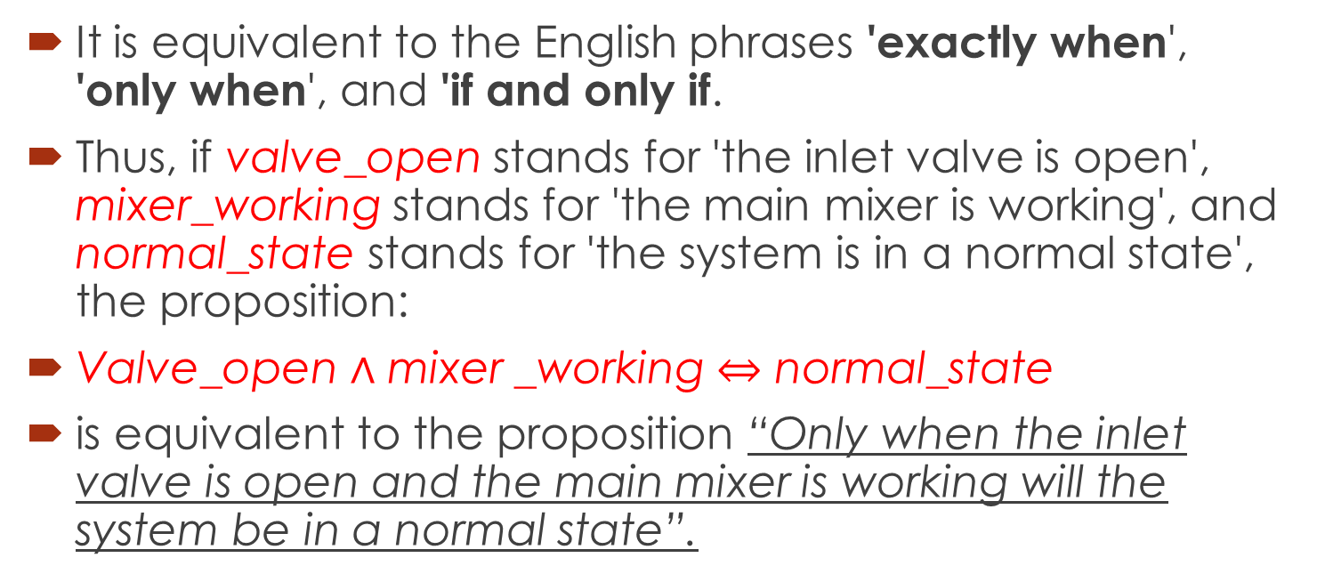

Equality operator “$⟺$”
It is equivalent to the English phrases 'exactly when', 'only when', and 'if and only if.
Thus, if valve_open stands for 'the inlet valve is open', mixer_working stands for 'the main mixer is working', and normal_state stands for 'the system is in a normal state', the proposition:
Valve_open $∧$ mixer _working $⇔$ normal_state
is equivalent to the proposition “Only when the inlet valve is open and the main mixer is working will the system be in a normal state”.

Slide 11
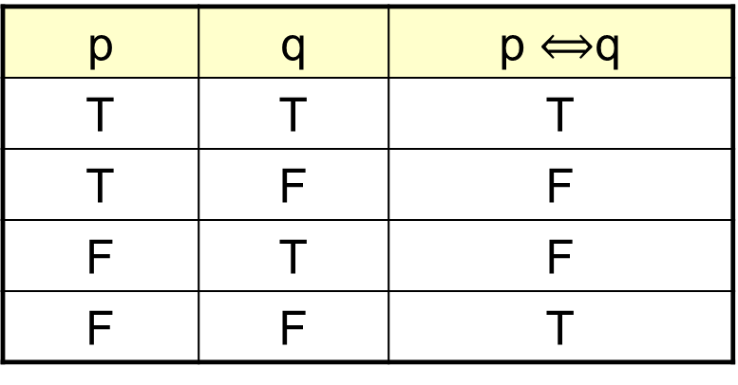

TRUTH TABLA FOR BICONDITIONAL
From the Truth Table of p $⟺$ q it is quite clear that p $⟺$ q have F where both p and q have different values and where both p and q have the same values we have T in the column of p $⟺$q. That is bi-conditional is true when p and q have same truth value.
p | q | p $⟺$q
T | T | T
T | F | F
F | T | F
F | F | T

Slide 12
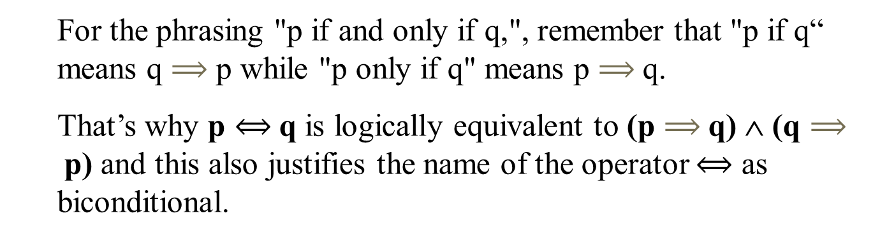
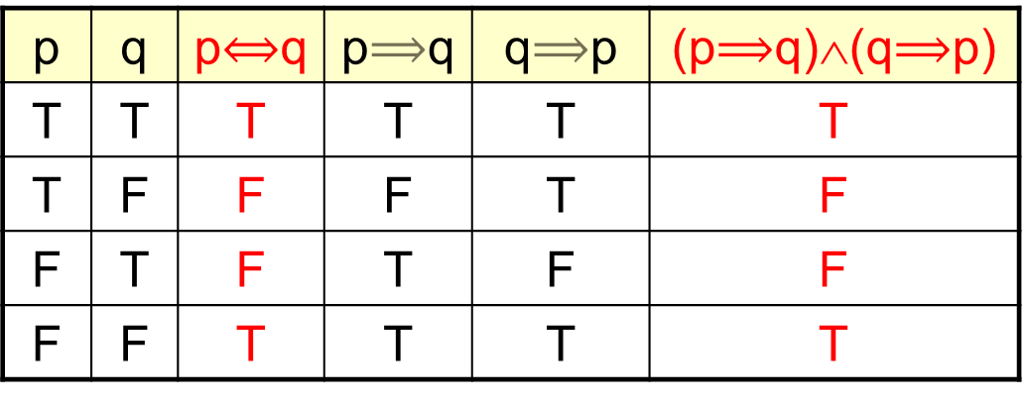

p $⟺$q ≡ (p$⟹$q)∧(q $⟹$p)
p | q | p$⟺$q | p$⟹$q | q$⟹$p | (p$⟹$q)∧(q$⟹$p)
T | T | T | T | T | T
T | F | F | F | T | F
F | T | F | T | F | F
F | F | T | T | T | T
For the phrasing "p if and only if q,", remember that "p if q“ means q $⟹$ p while "p only if q" means p $⟹$q.
That’s why p $⟺$q is logically equivalent to (p $⟹$q) ∧ (q $⟹$p) and this also justifies the name of the operator $⟺$ as biconditional.

Slide 13
EXERCISE
Rephrase the following propositions in the form “p if and only if q” in English.
For you to win an A grade in Formal Methods is necessary and sufficient that you have more than 85% marks.
Solution: You win an A grade in Formal Methods if and only if you have more than 85% marks.
If it is hot outside you buy an ice cream cone, and if you buy an ice cream cone it is hot outside.
Solution: You buy an ice cream cone if and only if it is hot outside.

Slide 14
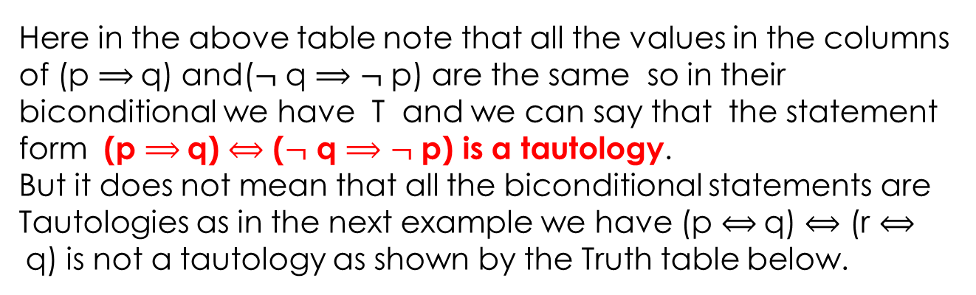
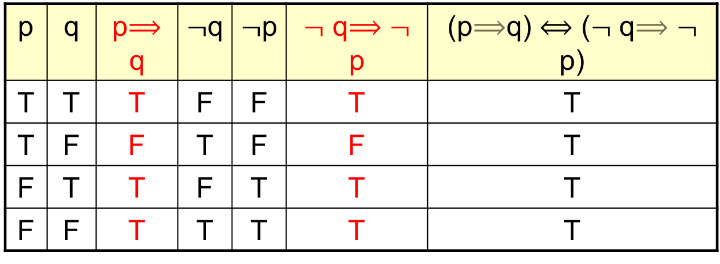

TRUTH TABLE FOR (p $⟹$q) $⟺$ ($¬$ q $⟹$ $¬$ p)
p | q | p$⟹$q | $¬$q | $¬$p | $¬$ q$⟹$ $¬$ p | (p$⟹$q) $⟺$ ($¬$ q$⟹$ $¬$ p)
T | T | T | F | F | T | T
T | F | F | T | F | F | T
F | T | T | F | T | T | T
F | F | T | T | T | T | T
Here in the above table note that all the values in the columns of (p $⟹$q) and($¬$ q $⟹$ $¬$ p) are the same so in their biconditional we have T and we can say that the statement form (p $⟹$q) $⟺$ ($¬$ q $⟹$ $¬$ p) is a tautology.
But it does not mean that all the biconditional statements are Tautologies as in the next example we have (p $⟺$q) $⟺$ (r $⟺$q) is not a tautology as shown by the Truth table below.

Slide 15
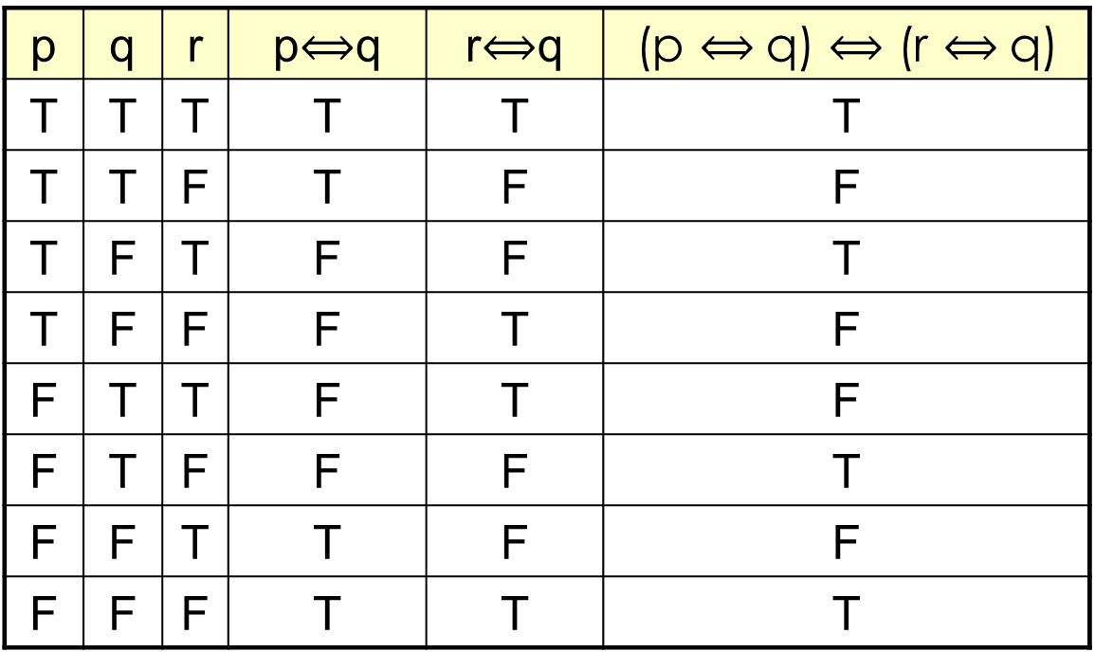

TRUTH TABLE FOR (p $⟺$q) $⟺$ (r $⟺$q)
p | q | r | p$⟺$q | r$⟺$q | (p $⟺$q) $⟺$ (r $⟺$q)
T | T | T | T | T | T
T | T | F | T | F | F
T | F | T | F | F | T
T | F | F | F | T | F
F | T | T | F | T | F
F | T | F | F | F | T
F | F | T | T | F | F
F | F | F | T | T | T

Slide 16
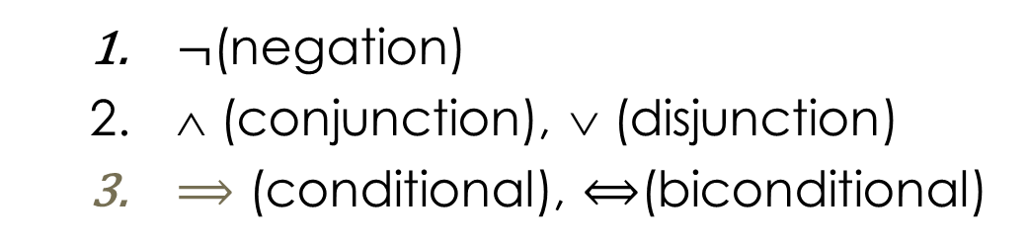
HIERARCHY OF OPERATIONS FOR LOGICAL CONNECTIVES
$¬$(negation)
∧ (conjunction), ∨ (disjunction)
$⟹$ (conditional), $⟺$(biconditional)

Slide 17
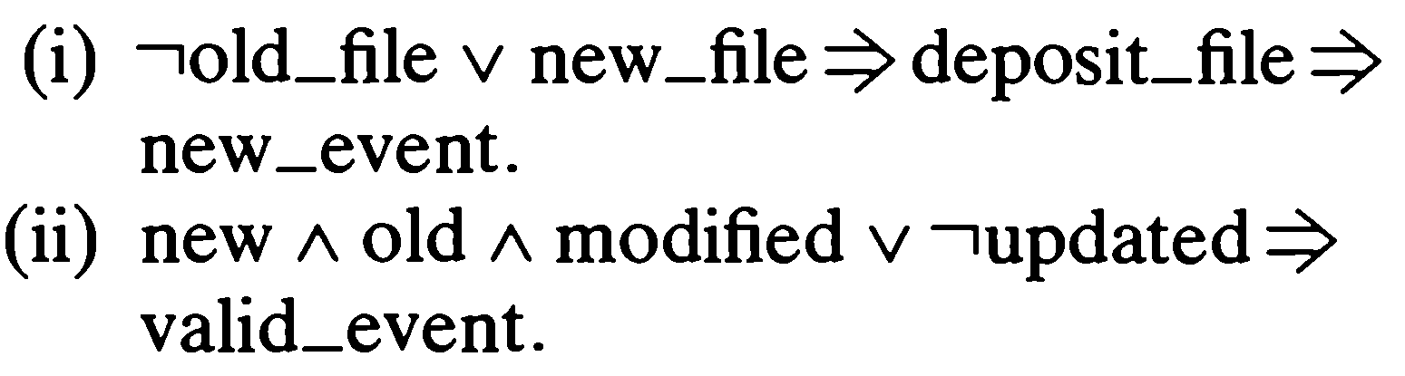
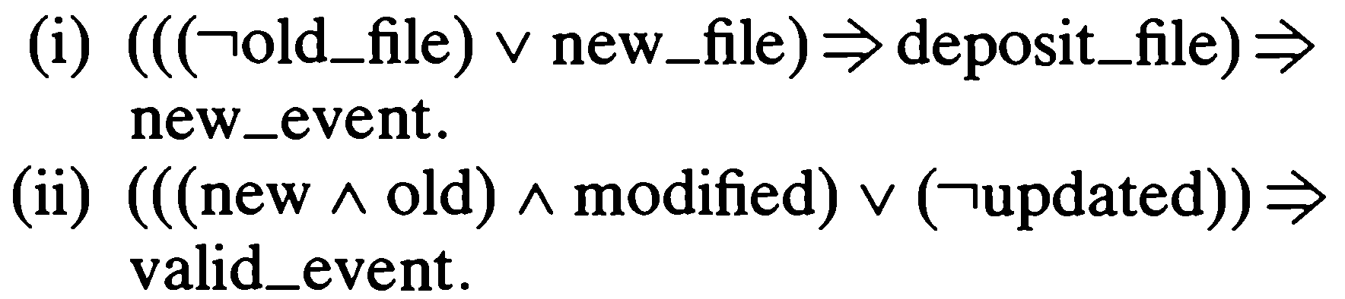
Example
Solution:

Slide 18
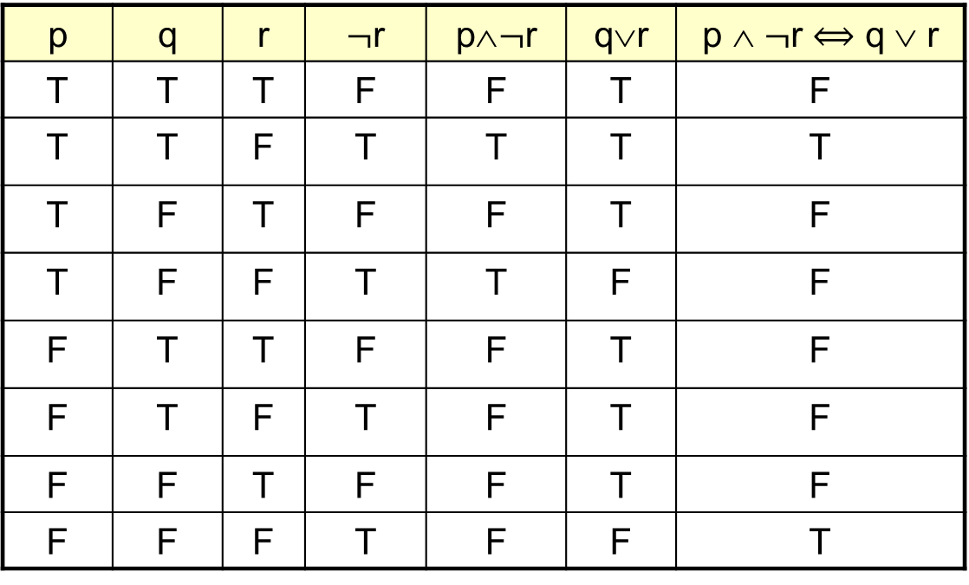


TRUTH TABLE FOR p ∧ $¬$r $⟺$ q ∨ r
Here p ∧ $¬$ r $⟺$q ∨ r means (p ∧ ($¬$ r)) $⟺$ (q ∨ r)
From the last column of the table we can easily see that (p $⟺$q) $⟺$(r $⟺$q) is not a Tautology.(Remember the definition of tautology, a statement is tautology if it has only its Truth values as “True” regardless the values of its constituents statements.)
p | q | r | $¬$r | p∧$¬$r | q∨r | p ∧ $¬$r $⟺$ q ∨ r
T | T | T | F | F | T | F
T | T | F | T | T | T | T
T | F | T | F | F | T | F
T | F | F | T | T | F | F
F | T | T | F | F | T | F
F | T | F | T | F | T | F
F | F | T | F | F | T | F
F | F | F | T | F | F | T

Slide 19
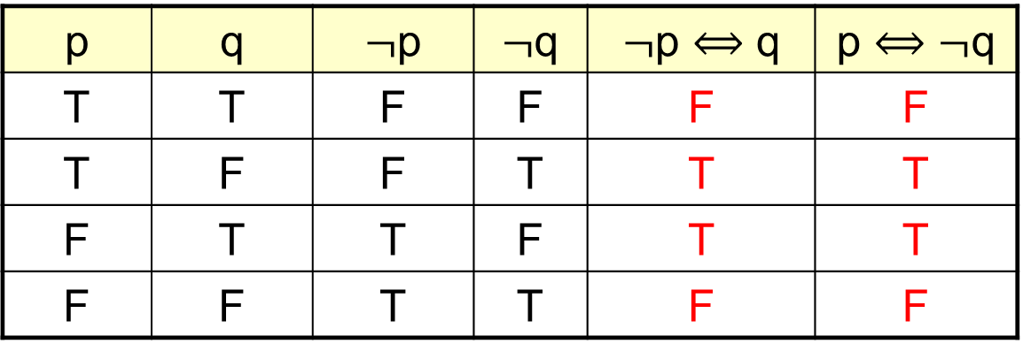
LOGICAL EQUIVALENCE INVOLVING BICONDITIONAL
Show that $¬$p $⟺$q and p $⟺$ $¬$q are logically equivalent
p | q | $¬$p | $¬$q | $¬$p $⟺$ q | p $⟺¬$q
T | T | F | F | F | F
T | F | F | T | T | T
F | T | T | F | T | T
F | F | T | T | F | F

Slide 20
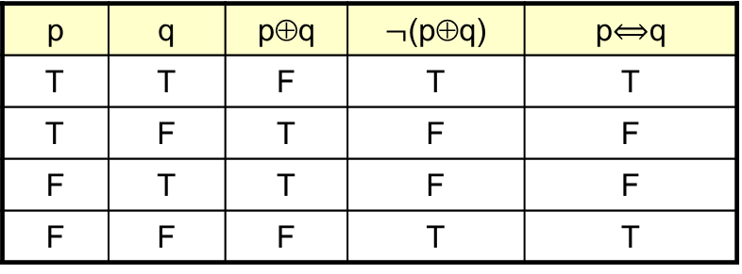

EXERCISE
Show that $¬$(p⊕q) and p $⟺$q are logically equivalent
Remember the logical connective ⊕ which we call “Exclusive or”. Exclusive or has false truth value when both statements are true or when both has truth value false.
Now note that the entries in the last two columns are same hence the corresponding statement forms are Logically equivalent.
p | q | p⊕q | $¬$(p⊕q) | p$⟺$q
T | T | F | T | T
T | F | T | F | F
F | T | T | F | F
F | F | F | T | T

Slide 21
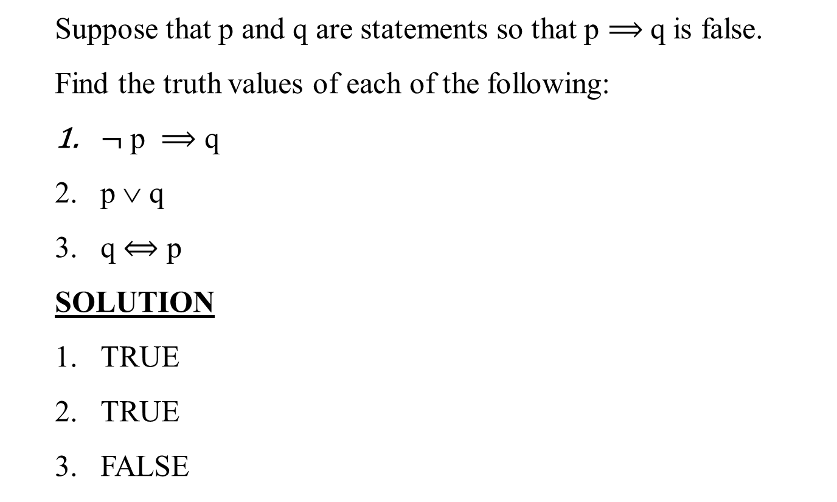
EXERCISE
Suppose that p and q are statements so that p $⟹$q is false.
Find the truth values of each of the following:
$¬$ p $⟹$ q
p ∨ q
q $⟺$ p
SOLUTION
TRUE
TRUE
FALSE

Slide 22
Summary of the lecture: conclusion
Contrapositive of conditional statements
Biconditional statements
Truth table for biconditional statement

Slide 23
Reference and reading material
Chapter # 3: Section 3.2 of the book “Software development with Z” by J.B. Wordsworth
Chapter # 2: of the book “Formal Software Development, from VDM to Java” by Quentin Charatan and Aaron Kans

